Slide 1

Field Communication Unit

Slide 2
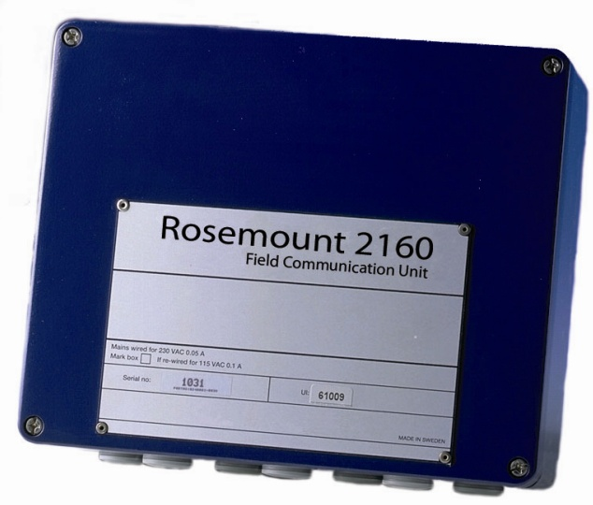
Lesson Goal
In this presentation:
2160 Field Communication Unit
Hardware, Functions, Communication, Write Protection and Reset, Default Database load, Slave database.
2165/2175 Field Communication Unit
Labwork
Configure 2160 Field Communication Unit Slave database

Slide 3
2160 Field Communication Unit

Slide 4
2160 Field Communication Unit
Improves update rate from field equipment
Continously collects data from field equipment
No explosion proof protection
Mounted in a non-hazardous area

Slide 5
2160 Communication Ports
6 Communication Ports, 2 types
Field Bus: Collects data from field equipment
Group Bus: Provides data to host systems
Standard Port Configuration
2 Group Buses
4 Field Buses
Possible to convert ports
Ports | X1 | X2 | X3 | X4 | X5 | X6
Alt 4+2 | FB | FB | FB | FB | GB | GB
Alt 3+3 | FB | FB | FB | GB | GB | GB
Alt 2+4 | FB | FB | GB | GB | GB | GB

Slide 6
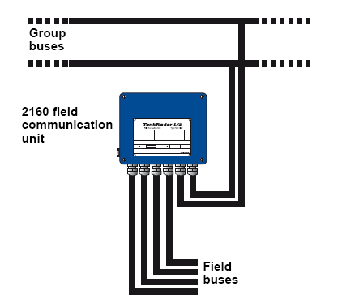
2160 Communication Ports
Communication Protocol:
Modbus rtu
Field Bus:
Modbus master
Group Bus:
Modbus slave
Holds its own modbus adress
Default 245
FCU use all its communication
ports simultaneaously
Possible to adjust if needed
Answers questions
Sends questions

Slide 7
2160 Communication Ports
Max 32 Units / 2160
Max 16 Units per Field Bus
Max 8 Units
2410/RLG
2410/RLG
2410/RLG
2410/RLG
2410/RLG
2410/RLG
2410/RLG
2410/RLG

Slide 8
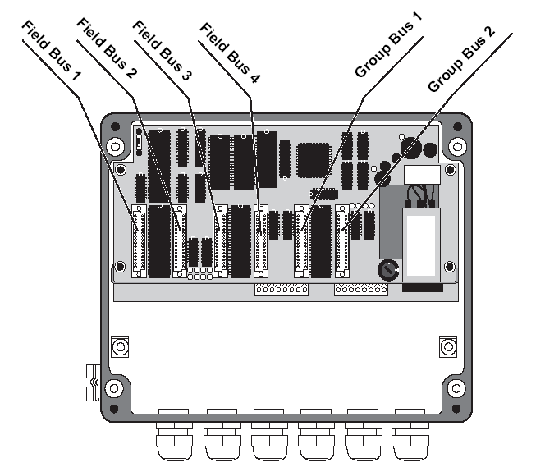
2160 Interface Cards
Each communication port need a communication interface card.
FCM = TRL2 bus
FCI = RS485
FCL = Labko ILS2000
RS232 = Local connectors X10,X11 Special jumper needed
Group Buses can be equipped with:
FCM, FCI, RS232
Field Buses can be equipped with:
FCM, FCL, FCI

Slide 9
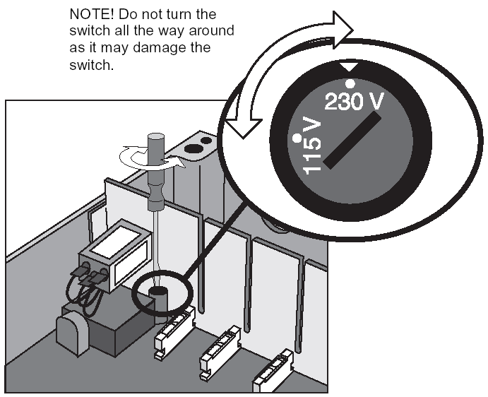
2160 Power Supply
Power supply 115 or 230VAC.
Two fuses (100mA) are located below the power terminal.
The 2160 should be grounded.

Slide 10
2160 Write protection & Reset
Write protection switch prevents unauthorized changes in the database.
Write protection position can be sealed.
Reset pushbutton makes a software restart of the CPU. (Keep pressed for 5 seconds)
Notes:
When write protecion is on, nothing can be changed
All information is stored in FCU, not in the PC
Push Reset button for 5 seconds and the FCU is restarted and the buffer is cleared

Slide 11
2160 Electronics
The main board is called FCP. (Field Communication Processor board)
Green LED’s:
Serial data received
Yellow LED’s:
Serial data transmitted
H13 Red LED:
Watch dog
H14 Green LED:
Power on
Led indications:
Group Bus (slave): Green (Question) -> Yellow (Answer)
Field Bus (master): Yellow (Questions) -> Green (Answer)

Slide 12
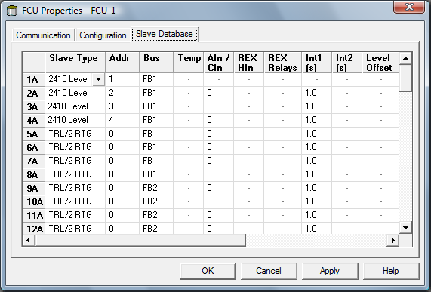
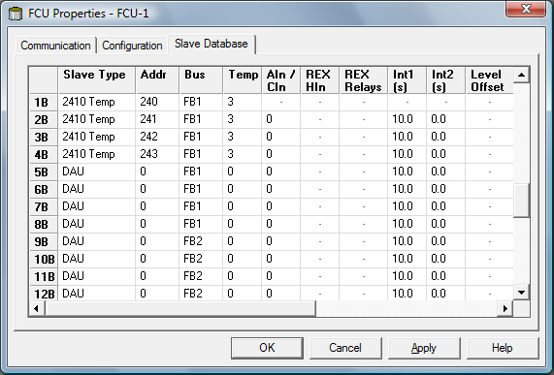
2160 Slave Database
Holds the information about connected devices.
Modbus Adress
Field Bus
Type of device
Device Configuration
Database is divided in two parts.
A-section for level gauges.
B-section for 2410 Aux & DAU’s.
2410 Temp: 2240S
DAU & 2410 Temp related to a gauge must be installed at same position, xA vs xB.
Slave database has to be configured before any installation of gauges.
Only configure the slave database for connected gauges.

Slide 13
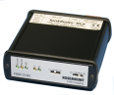
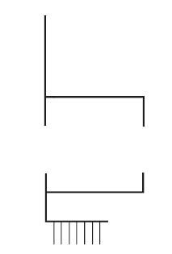

2160 Redundancy
Almost failsafe communication from field
GB´s and FB´s in parallell
Redundancy cable
One primary one secondary
If primary fails, secondary takes over
Installation guide in TankMaster
Drawing 9240 007-988
2160 Field Communication Unit
Groupbus
Prim.
Sec.
Sec.
Prim.
Fieldbus
FCU1:X11
FCU2:X11
4 5 6
4 5 6
Notes:
Redundancy of FCUs gives almost failsafe communication from field
GB’s and FB’s has to be connected in parallell.
A redundancy cable need to be installed between the FCU’s on X11.
One FCU will be ’primary’ and the other one ’secondary’.
If the ’primary’ FCU fails the ’secondary’ will take over all communcation.
Installation guide in Tank Master.

Slide 14
2165/2175 Field Communication Unit
2175 Field communication Unit
2165 Field communication Unit

Slide 15
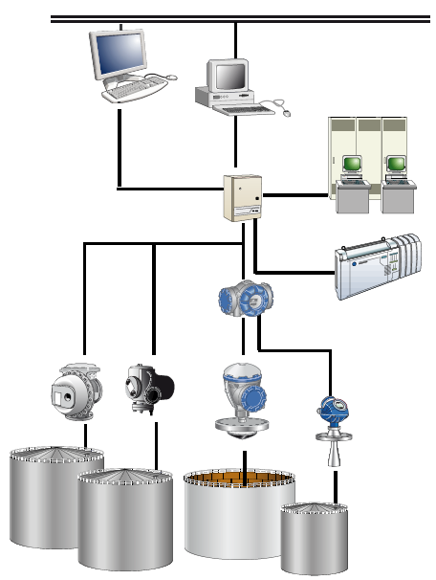
2165/2175 Field Communication Unit
2165/2175 for emulation purpose
collect data from other gauge vendor´s equipment
Provide data to other vendor´s host systems
Collect data from different field bus interfaces and protocols simultaneously
Exchange old equipment
Unlock competitor´s sites
TankMaster PC
Existing host system from an other vendor
Other vendors’ gauges
2410 Tank Hub
Rosemout 5900S and 5300 or 5400

Slide 16
2165/2175 Specification
 | 2165 | 2175
Hazardous Area | No | No
Ambient Temperature | -20°C to +70°C | -20°C to +70°C
Power Supply | 115/230VAC (25W) | 115/230VAC (25W)
Ingress Protection | IP 65 | IP 21
Dimensions | 111 x 313 x 404 mm | 19” rack
Ports | 10 (6 fieldbuses) + 2 engineering ports | 8, 16, 24 or 32
Redundancy | Yes | Yes

Slide 17
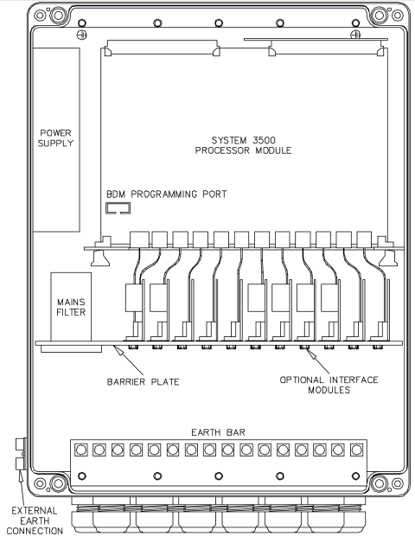
2165 Ports
Ethernet Configuration Port
Configuration of ports, drivers, gauge addresses...
Configuration tool software
Engineering port
Set up IP address/ subnet mask
Supervise log operation of drivers
Terminal program e.g. Windows Hyper Terminal
HOST port
Field Bus Port
Ports | Type
ETHERNET | ETHERNET Configuration Port
SER2 | Field Bus Port
SER3 | Field Bus Port
SER4 | RS232 Engineering Port
SER5 | RS232 Host Port
SER6 | RS232 Host Port
SER7 | Field Bus Port
SER8 | Field Bus Port
SER9 | Field Bus Port
SER10 | Field Bus Port
SER11 | RS232 Host Port
SER12 | RS232 Host Port
Serial Ports 2-12

Slide 18
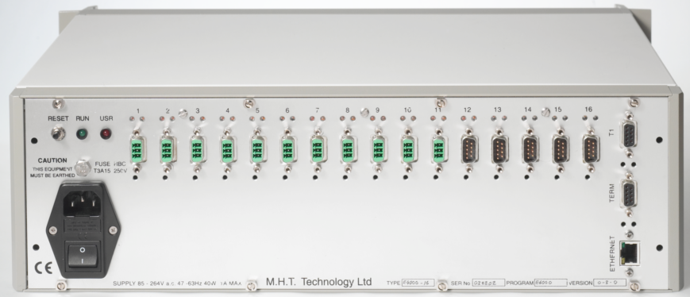
2175 Ports
Ports | Type
8-32 | Host / Field Bus Ports
T1 | Reserved
TERM | Engineering Port
ETHERNET | ETHERNET Configuration Port

Slide 19
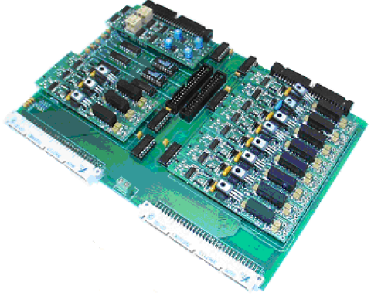
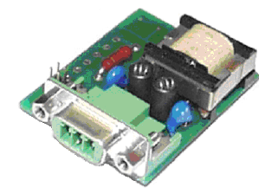
2165/75 Modules
Field Interface Modules
Provides electrical interface to field bus
Connected directly on the motherboard
Available electrical interfaces
RS232, 422, 485
Enraf Bi Phase Mark
Rosemount TRL/2
Whessoe Current Loop
Field Isolation Module
Provides electrical isolation
Transient protection

Slide 20


2165/75 drivers
Field Buses
Rosemount FCU/FBM
TRL2/Rex System
Enraf CIU/BPM
802/811/813 GPP Servo
811/813/854 GPU Servo
873/971/973 GPU RTG
Krohne
BM70 RTG
Whessoe WM500
1071 Outstation
1311 Transmitter
1140 Servo
Whessoe WM550
1315 Transmitter
ITG 50/60/70 servo
Motherwell 4000/2800
2800 Servo
Varec
1800
1900
GPE
Modbus Master
Hosts
TankMaster
Enraf CIU 858 Slave
Emulates CIU 8508
Enraf ENTIS XL
Enraf MICROLECT
FoxBoro I/A
Modbus Slave

Slide 21

PreConfiguration
2165/75 can be pre-configured at factory
FCU type/ports
2165/10
Gauge/Devices/Hosts
50 Enraf 873, 10 REX, TM
Protocol Setting
Enraf: GPU 1200,O,7,2
REX/Raptor: TRL/2 4800,N,8,1
Gauge/Device addresses:
Enraf 1,2,3,4,5...
REX/Raptor 1,2,3,4,5...
Gauge/Device parameters:
Enraf: Level, Avg. temp., pressure
REX/Raptor: Level, Avg. temp., vapor pressure

Slide 22
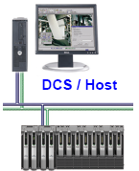
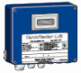
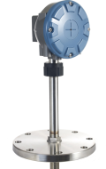

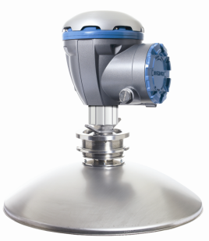
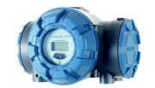
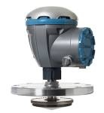
Connect Rex & Raptor system to FCU
Rex 3950 Adress:
FCU2160
Adress:
Tank Master PC
1
201
SDAU Adress: 14 temp
DCS
101
RDU40 Adress:
N/A
2240 Temp Adress: 16 temp
FB 1 2 3 4
1 2 GB
106
2230 Display Adress:
5900S 2-in-1 Adress:
Tank Hub Adress:
N/A
6/56
DU2210 Adress:
106
N/A
Rex 3920 Adress: 6 temp 1 Analog In
2
Tank Hub Adress:
104
Tank Hub Adress:
Pro Platinum Adress: 6 Temp
105
3
5900S 2-in-1 Adress:
4/54
5900S Adress:
5
Notes:
ATD? Eller skall vi kalla dom 2230 och 2240?

Slide 23
Configure FCU Slave Database
REX RTG
1
FB 1
0
1
10
REX RTG
2
FB 2
6
1
1
10
PRO RTG
3
FB 2
6
1
10
2410 Level
4
FB 3
0
1
10
2410 Level
54
FB 3
0
1
10
2410 Level
5
FB 4
0
1
10
2410 Level
6
FB 4
0
1
10
2410 Level
56
FB 4
0
1
10
1
10
1
10
DAU
101
1
14
10
10
10
10
10
10
2410 Temp
104
FB 3
16
10
10
2410 Temp
104
FB 3
16
10
10
2410 Temp
105
FB 4
10
10
2410 Temp
106
FB 4
16
10
10
2410 Temp
106
FB 4
16
10
10
10
10
10
10

Slide 24
FCU Lab work
Check the power switch.
In what position is the switch?
We use 230 VAC in Sweden.
Default load the FCU.
See the "REX Service manual" page 93-94.
Check the LED:s in the FCU.
What color have the LED:s?
They don't flash, why?
Check the Unit ID.
Where can you see the Unit ID?
Notes:
Utöka?

